Slide 1
QUANTUM project:
Developing a data quality and utility label for HealthData@EU
European Health Data Space for secondary use
Name of the event | Place | Year, Month, Day
Presenter name | Presenter affiliation & role in QUANTUM
Email address

Slide 2
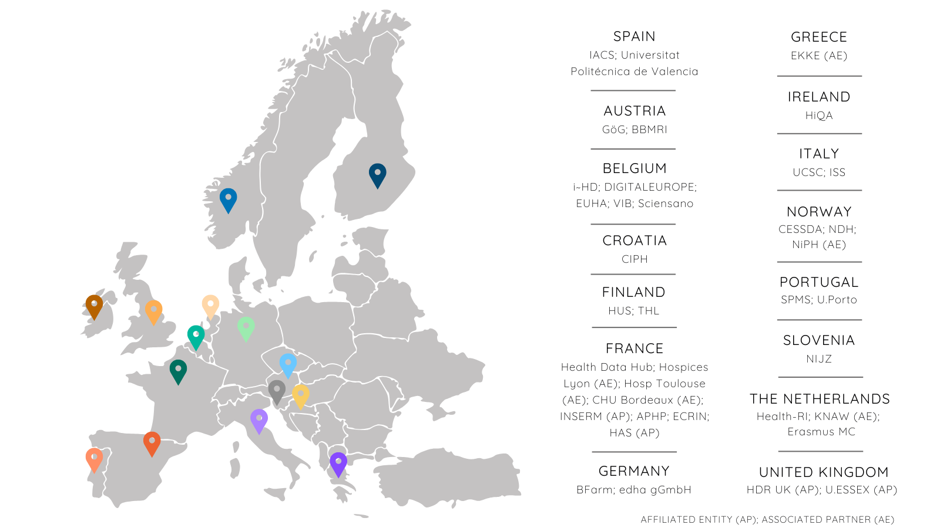
QUANTUM consortium
35 partners from 15 countries
Health Data Access Bodies (HDABs)
Data Holders (DHs)
Data Users (DUs)
Stakeholder community
HealthData@EU forum
Projects forum
Patients/citizens forum
Advisory board

Slide 3

What’s the challenge?
Differences in data quality, standards and interoperability
Different countries and health data actors in the EU collect and store health data in different ways.
This makes it hard to create a uniform system that ensures all data is of high quality and meets the standards set by the European Health Data Space (EHDS) regulations.

Slide 4

QUANTUM’s mission is to:
To meet the standards set by the European Health Data Space (EHDS) regulations
Create a common label system that guarantees the quality and utility of datasets for scientific and health innovation purposes.
QUANTUM responds to the European Health Data Space for secondary use = HealthData@EU

Slide 5
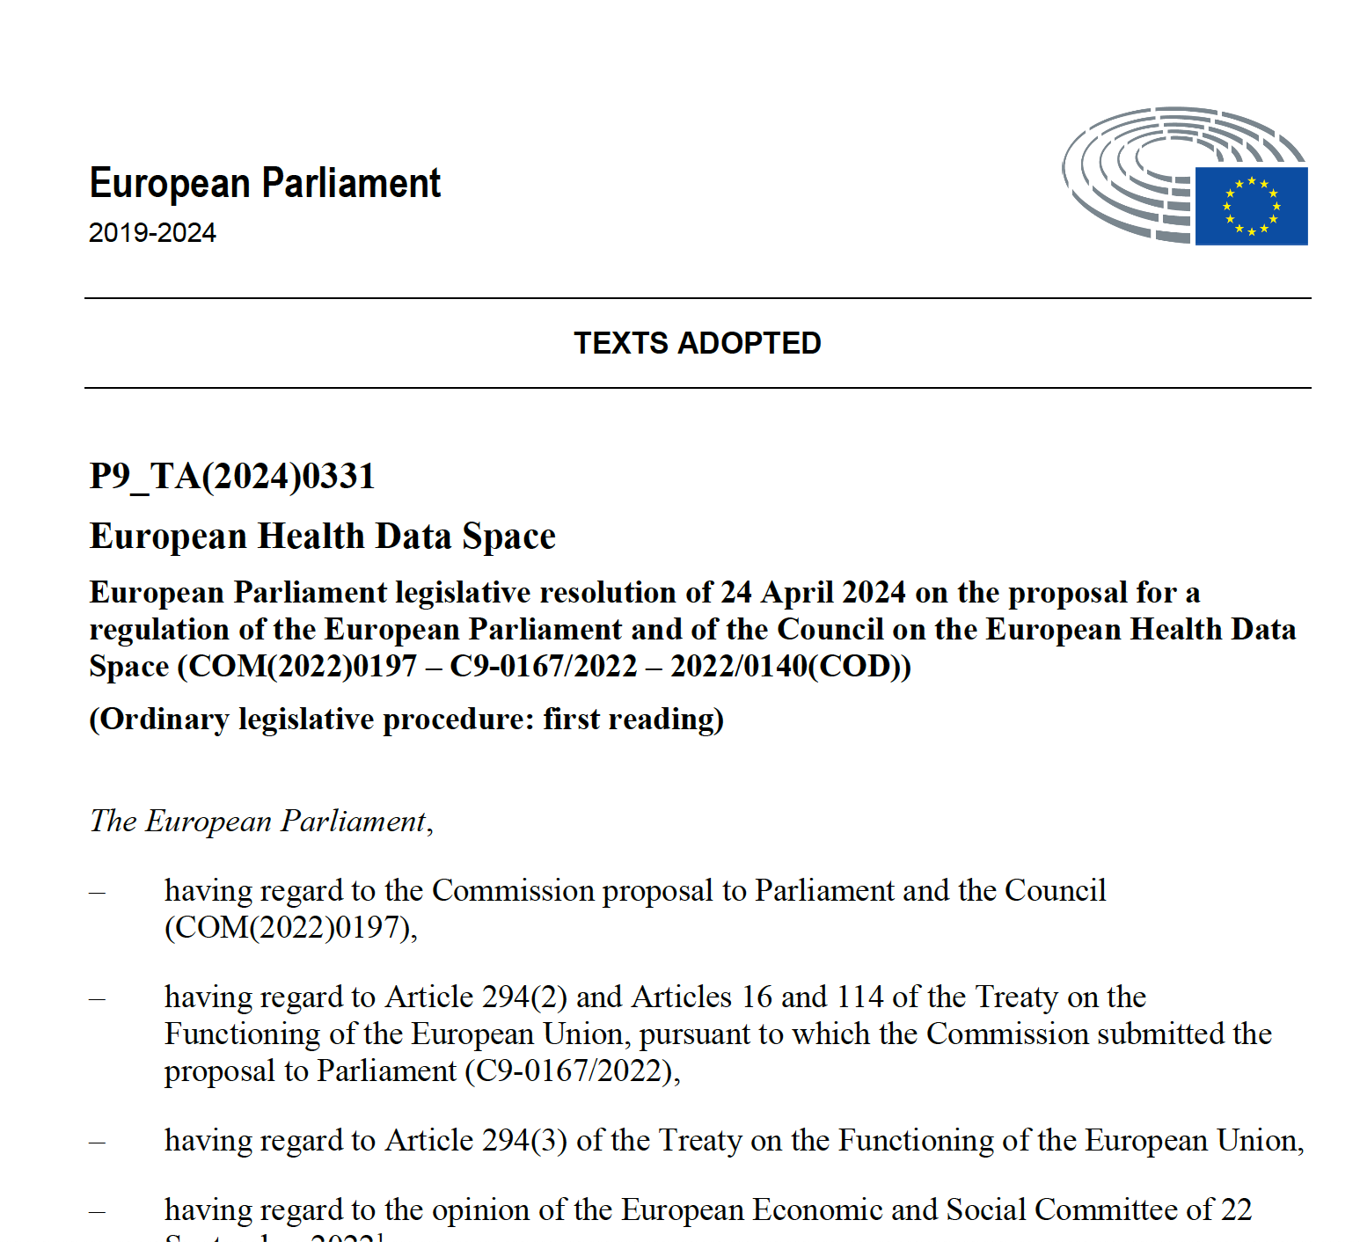
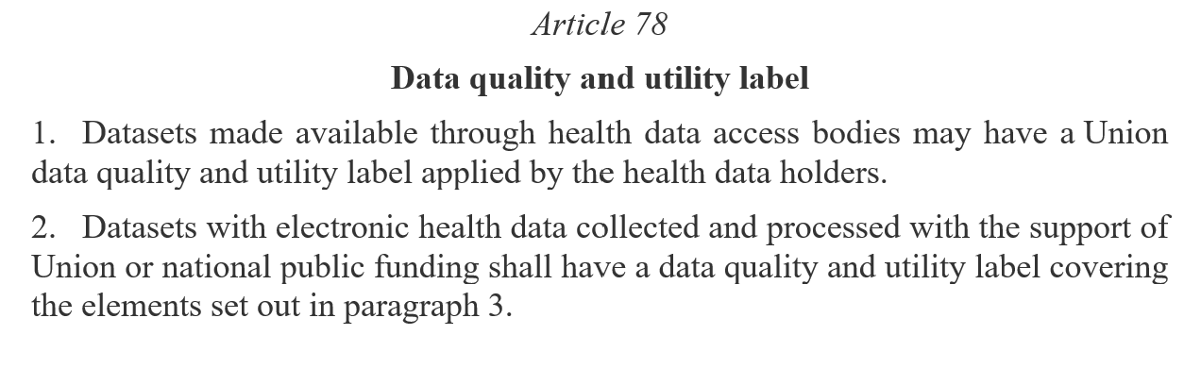
QUANTUM will address HealthData@EU article 78
European Health Data Space – Chapter IV
https://eur-lex.europa.eu/eli/reg/2025/327/oj/eng

Slide 6
Article 78. Elements in the label
The data quality and utility label shall cover the following elements, where applicable:
(a) for data documentation: meta-data, support documentation, data dictionary, format and standards used, provenance, and when applicable, data model;
(b) for assessment of technical quality: completeness, uniqueness, accuracy, validity, timeliness and consistency of the data;
(c) for data quality management processes: level of maturity of the data quality management processes, including review and audit processes, biases examination;
(d) for assessment of coverage: time period, population coverage and, when applicable, representativity of population sampled, and average timeframe in which a natural person appears in a dataset;
(e) for information on access and provision: time between the collection of the electronic health data and their addition to the dataset, time to provide electronic health data following an electronic health data access application approval;
(f) for information on data modifications: merging and adding data to an existing dataset, including links with other datasets;
(fa) where a data quality and utility label accompanies the dataset pursuant to Article 78, the health data holder shall provide sufficient documentation to the health data access body for that body to confirm the accuracy of the label

Slide 7


QUANTUM builds on
TEHDAS and the EHDS2 pilot
Conceptual building blocks towards the HealthData@EU
TEHDAS’ concepts in real contexts

Slide 8





QUANTUM backbone
A common concept for the datasets quality and utility
A common concept of the level of Data holders maturity
Piloting and implementation of the label in QUANTUM data holders
Translating QUANTUM label into recommendations for HealthData@EU
Setting-up a long-lasting data quality community of practice

Slide 9
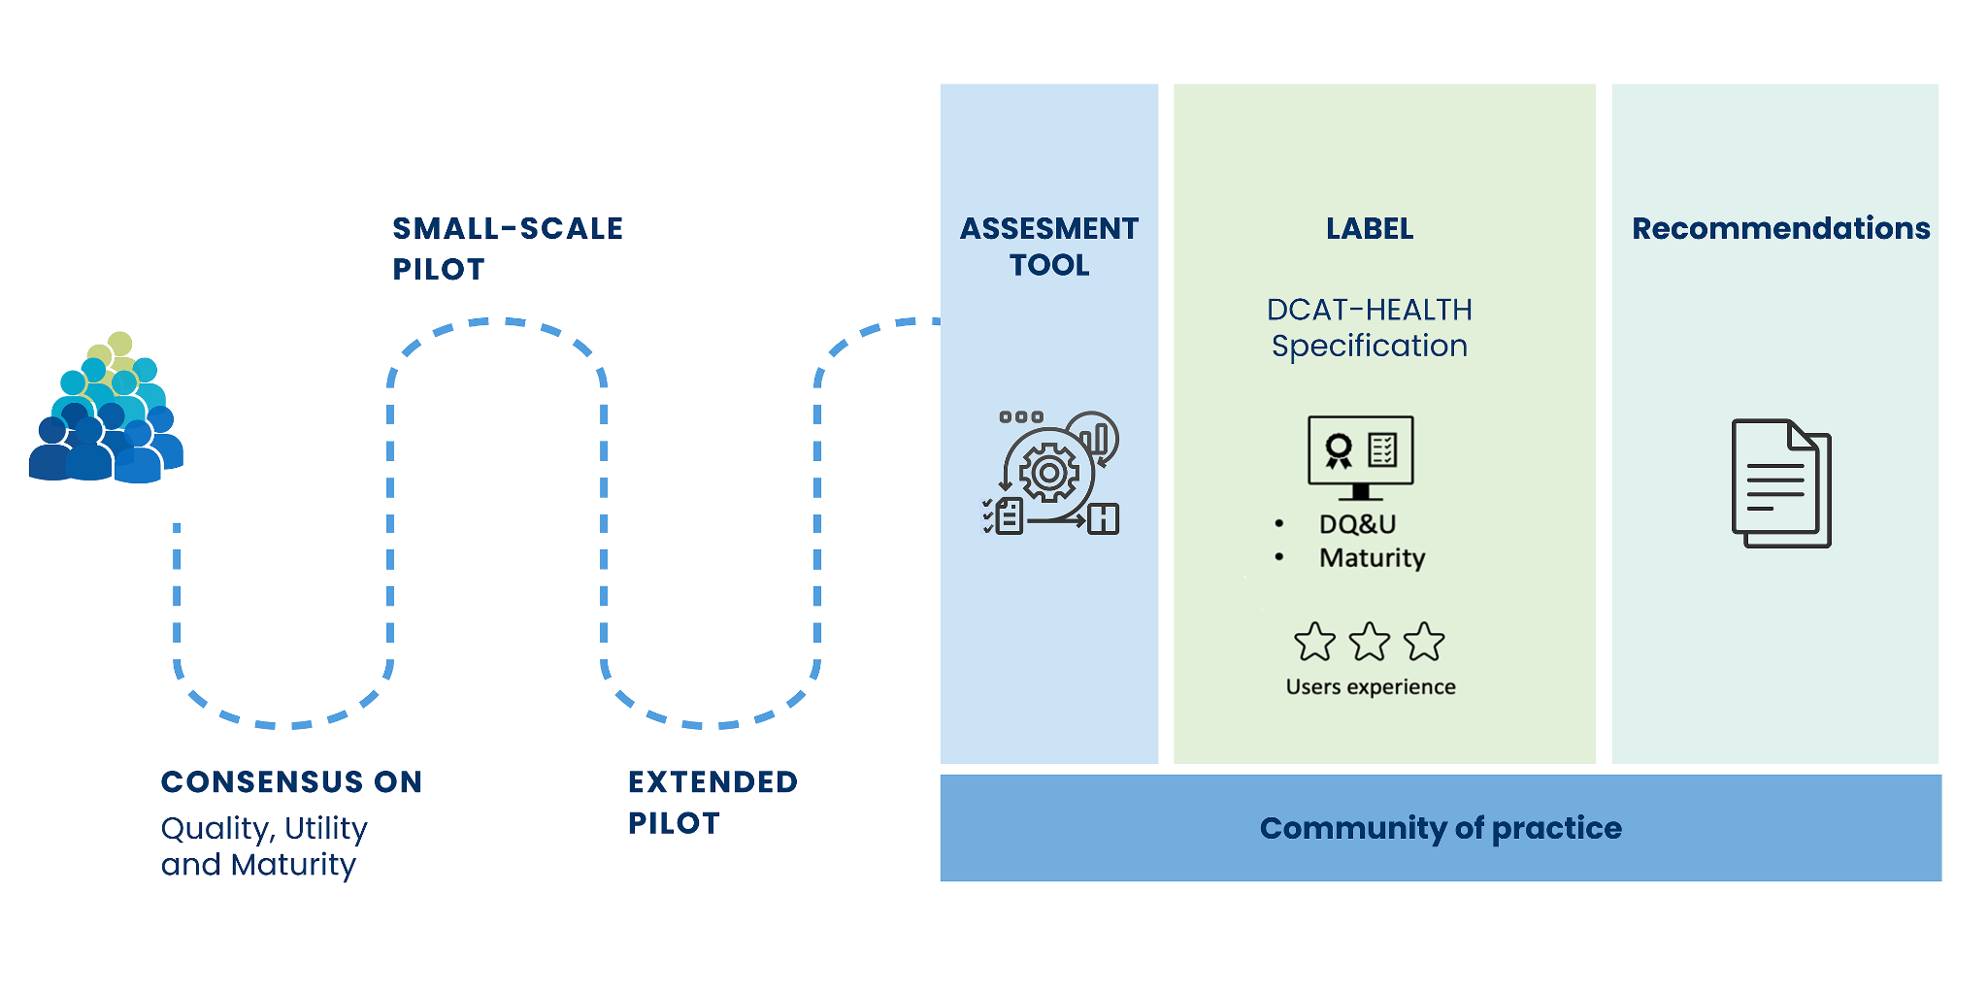
QUANTUM pathway towards the HealthData@EU

Slide 10
Who will benefit from QUANTUM?
Data Users
“QUANTUM's labelling mechanism will facilitate the search for high-quality datasets, ensuring you find data that fits your research needs”
Data holders
“QUANTUM's quality label will enhance the visibility and impact of your datasets, showcasing your commitment to excellence and utility in health data.”
Health Data Access Bodies (HDAB)
“QUANTUM's specifications will allow you to set up a strong supervision framework, fostering trust and transparency in health data use across Europe.”
Primary Collectors of Health Data (Data Producers)
"QUANTUM labelling mechanism will facilitate data reusability for secondary purposes, providing clear guidance on improving primary data collection."
European Commission
"QUANTUM will deliver the technical specifications for the HealthData@EU, facilitating a standardised approach to data quality, utility, and maturity labelling."
General Public (Citizens/patients)
"Your health data can generate breakthroughs in research. QUANTUM's labelling informs you about how your data contributes to meaningful advances in healthcare."

Slide 11
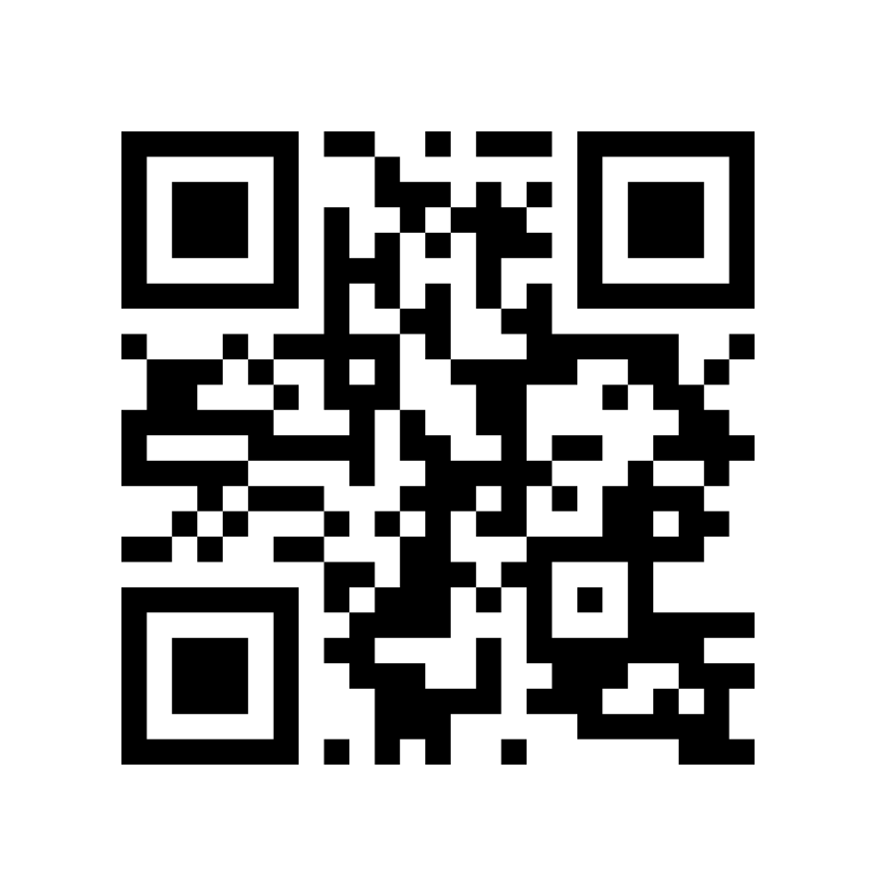
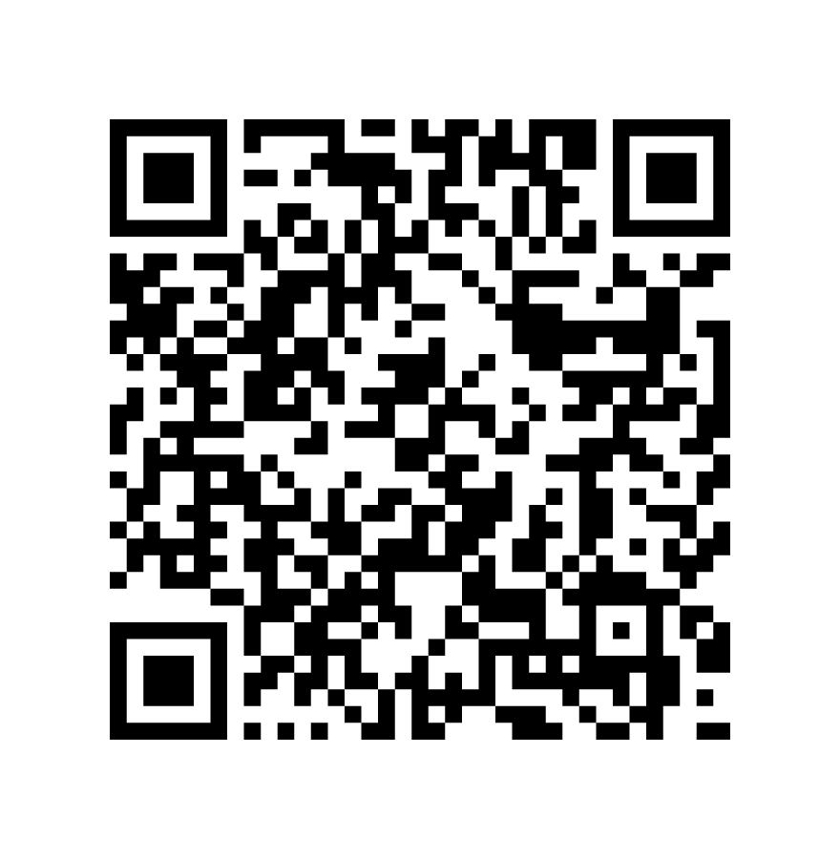
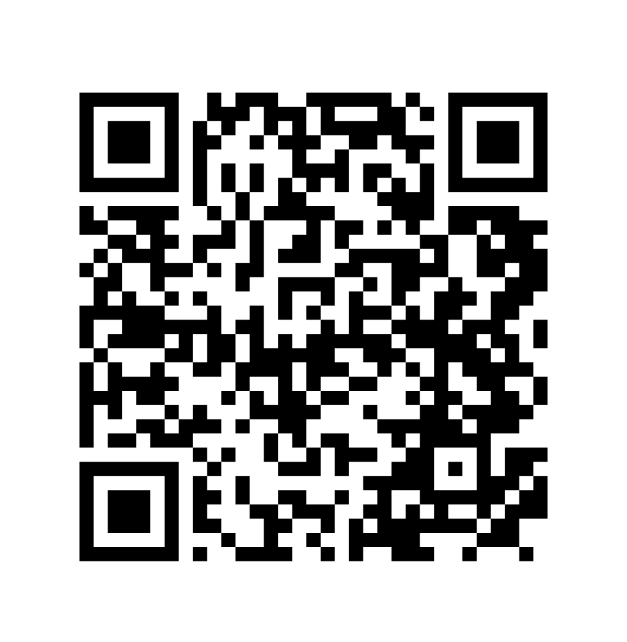
Get involved!
Scan me!
Visit our website
www.quantumproject.eu
Subscribe to our Newsletter
Join our Network
@quantumproject

Slide 12


Thank you!
Contact us:
info@quantumproject.eu
https://www.quantumproject.eu/
@quantumproject

